Slide 1
Title

Slide 2
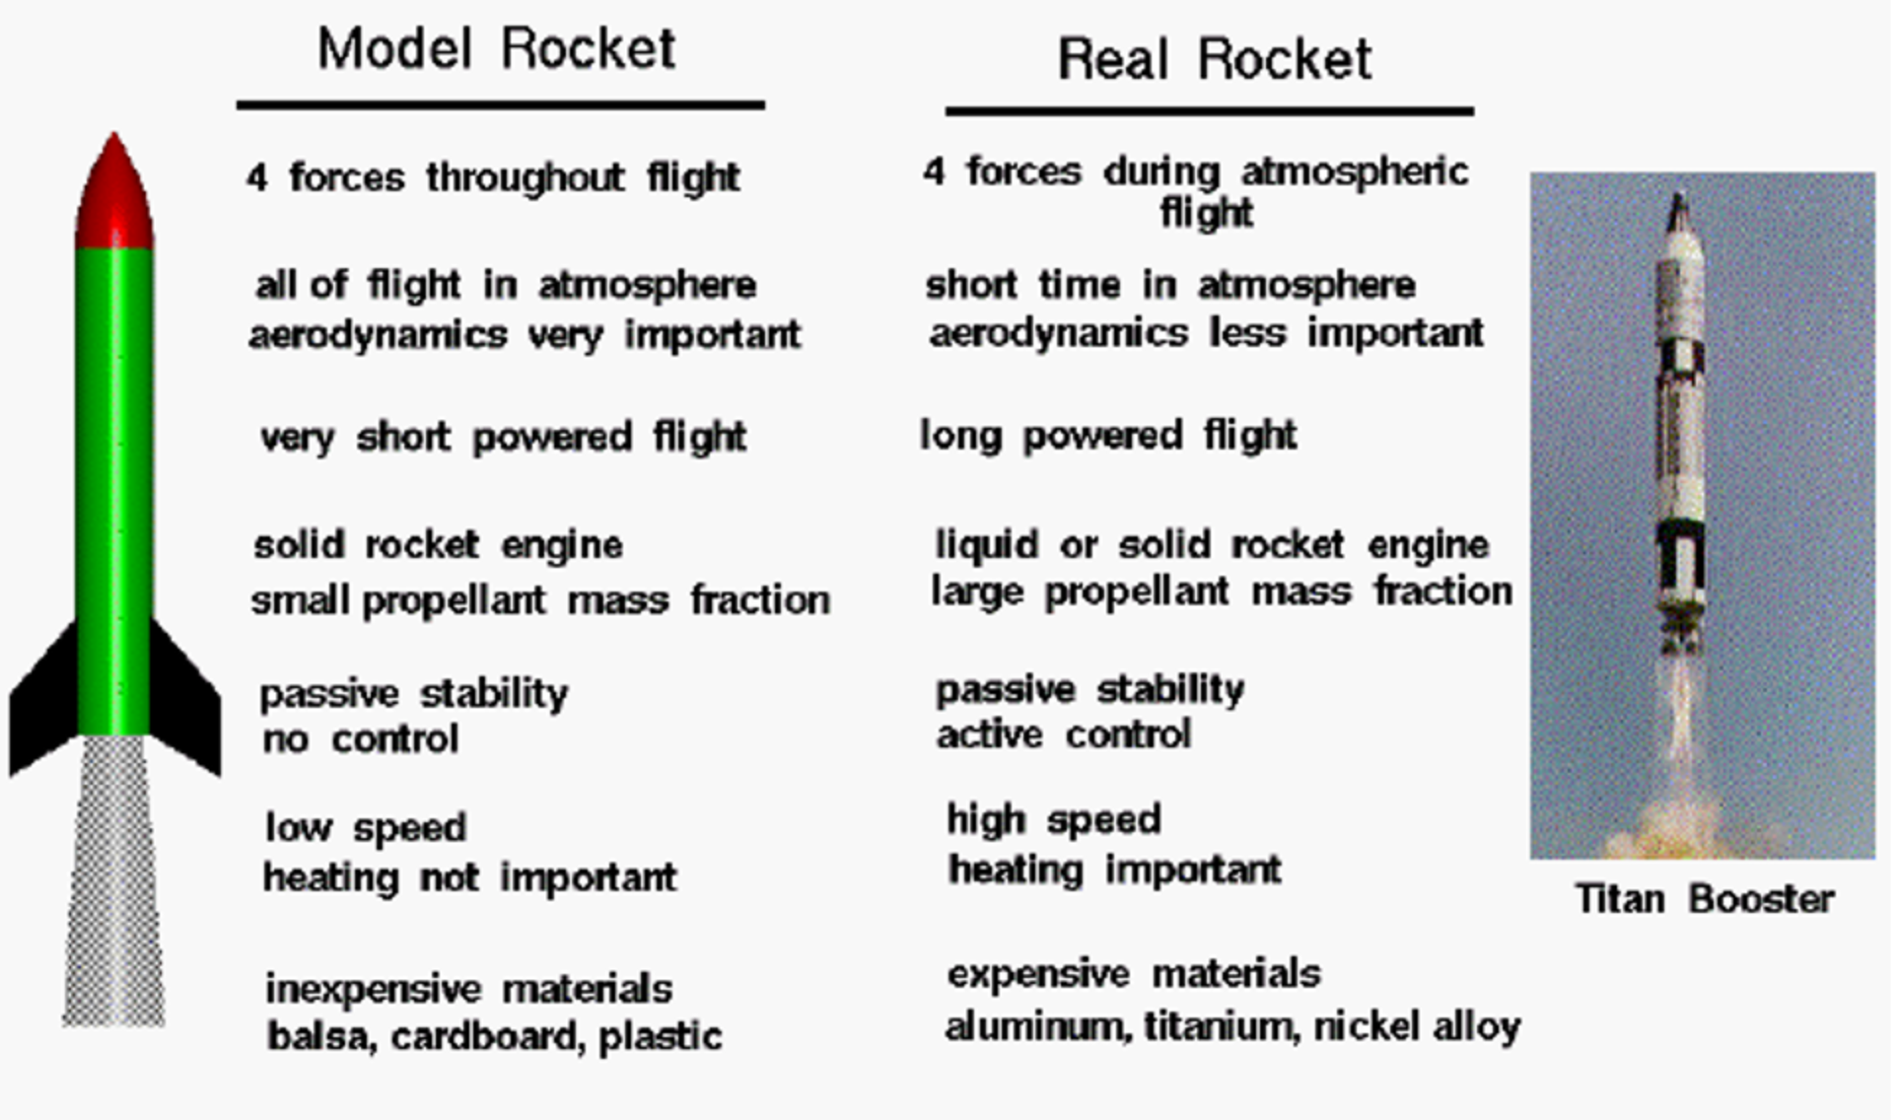

Slide 3
CONTENTS OF THIS TEMPLATE
You can delete this slide when you’re done editing the presentation
Fonts | To view this template correctly in PowerPoint, download and install the fonts we used
Used and alternative resources | An assortment of graphic resources that are suitable for use in this presentation
Thanks slide | You must keep it so that proper credits for our design are given
Colors | All the colors used in this presentation
Icons and infographic resources | These can be used in the template, and their size and color can be edited
Editable presentation theme | You can edit the master slides easily. For more info, click here
For more info: SLIDESGO | BLOG | FAQS
You can visit our sister projects: FREEPIK | FLATICON | STORYSET | WEPIK | VIDEVO

Slide 4
TABLE OF CONTENTS
01
02
03
OBSERVATORY
TELESCOPES
SATELLITES
You could describe the topic of the section here
You could describe the topic of the section here
You could describe the topic of the section here

Slide 5
INTRODUCTION
Here you could give a brief description of the topic you want to talk about. For example, if you want to talk about Mercury, you could say that it’s the smallest in the entire Solar System

Slide 6
WHOA!
This could be the part of the presentation where you can introduce yourself, write your email…

Slide 7
01
ASTRONOMICAL OBSERVATORY
You could enter a subtitle here if you need it

Slide 8
OBSERVE CELESTIAL OBJECTS
Mercury is the closest planet to the Sun and the smallest one in the entire Solar System. This planet's name has nothing to do with the liquid metal, since Mercury was named after the Roman messenger god.
Despite being closer to the Sun than Venus, its temperatures aren't as hot as that planet's.
Mercury takes a little more than 58 days to complete its rotation, so try to imagine how long days must be there!
Since the temperatures are so extreme, albeit not as extreme as in Venus, and the solar radiation is so high, Mercury has been deemed to be non-habitable for humans

Slide 9
ELECTROMAGNETIC SPECTRUM
Do you know what helps you make your point clear? Lists like this one:
They’re simple
You can organize your ideas clearly
You’ll never forget to buy milk!
And the most important thing: the audience won’t miss the point of your presentation

Slide 10
OUR OPTICAL OBSERVATORIES
A
B
MERCURY
VENUS
Mercury is the closest planet and the smallest one in the Solar System
Venus has a beautiful name and is the second planet from the Sun

Slide 11
COSMIC RADIO WAVE EMITTERS
MARS
JUPITER
MERCURY
Despite being red, Mars is actually a very cold place
Jupiter is a gas giant and the biggest in the Solar System
It’s the closest planet to the Sun and the smallest one

Slide 12
OBSERVE EARTH SATELLITES
VENUS
MERCURY
Venus is the second planet from the Sun
Mercury is the closest planet to the Sun
MARS
JUPITER
Despite being red, Mars is a cold place
Jupiter is the biggest planet in the Solar System

Slide 13
STUDY CELESTIAL SOURCES
MERCURY
JUPITER
Mercury is the closest planet to the Sun
Jupiter is the biggest planet of them all
VENUS
SATURN
Venus is the second planet from the Sun
Saturn is composed mostly of hydrogen and helium
NEPTUNE
MARS
Neptune is the farthest planet from the Sun
Despite being red, Mars is actually a cold place

Slide 14
AWESOME WORDS

Slide 15
—SOMEONE FAMOUS
“This is a quote. Words full of wisdom that someone important said and can make the reader get inspired.”

Slide 16
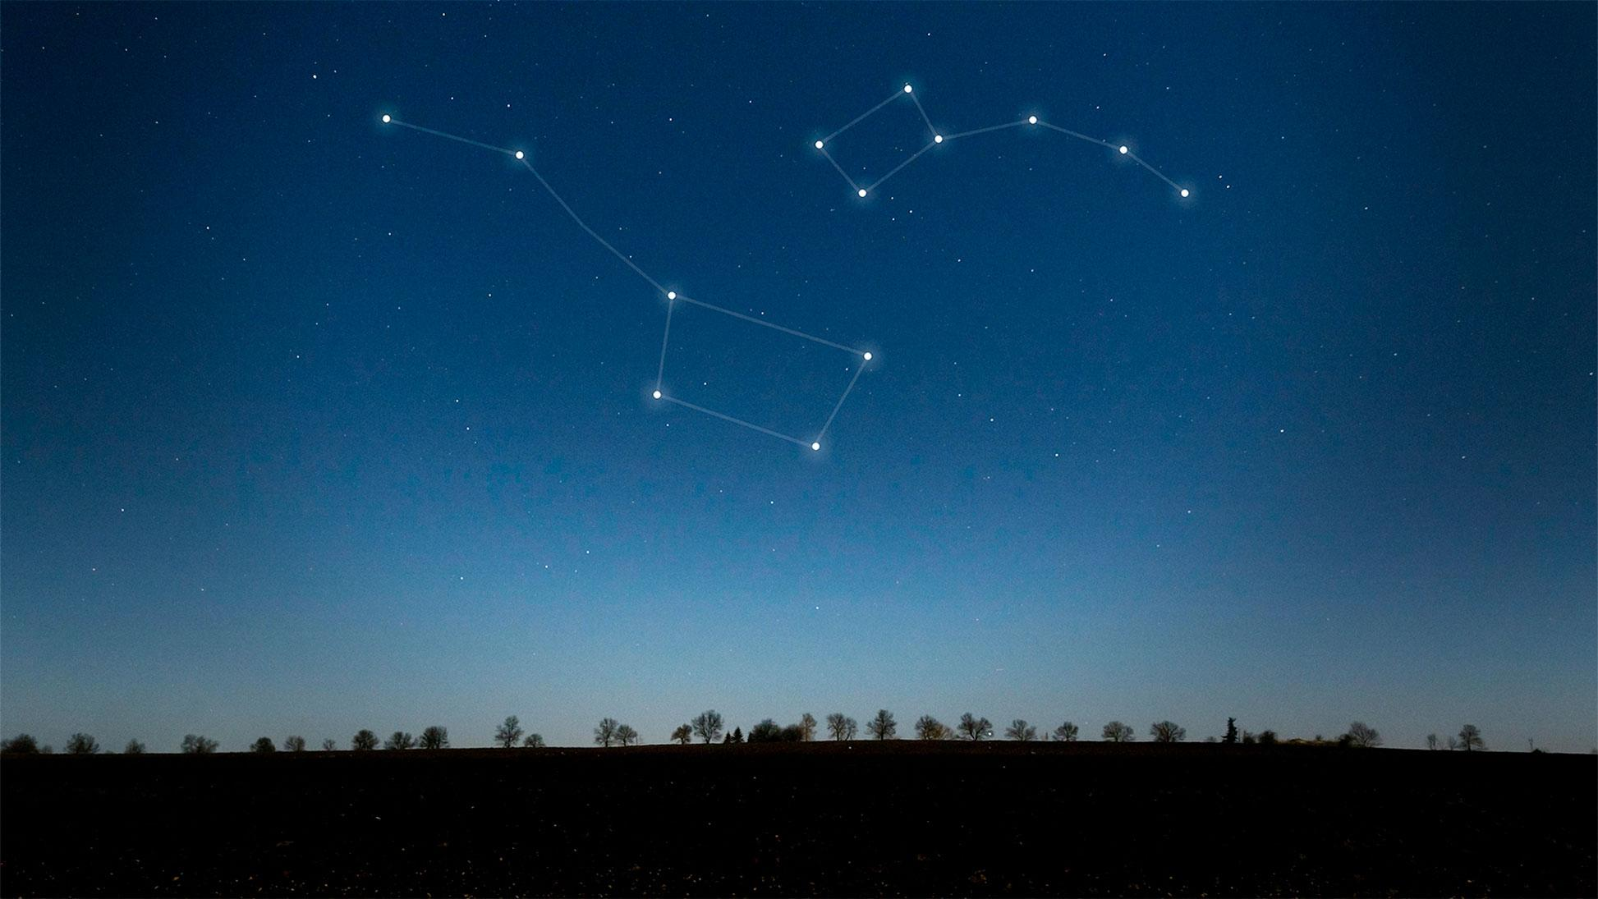
A PICTURE IS WORTH A THOUSANDS WORDS

Slide 17
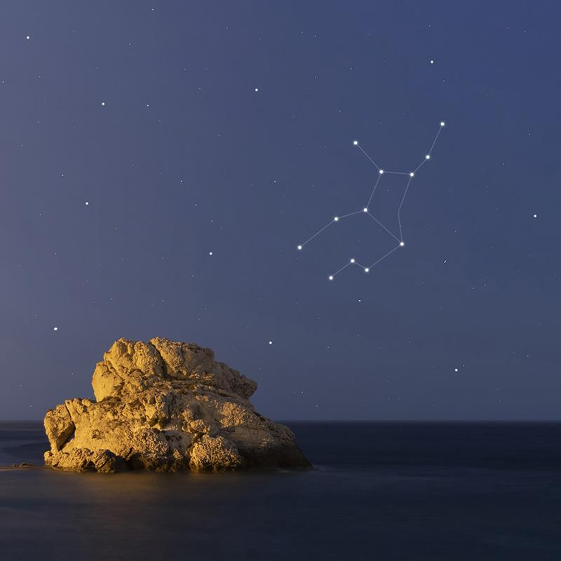
A PICTURE REINFORCES THE CONCEPT
Images reveal large amounts of data, so remember: use an image instead of a long text. Your audience will appreciate that

Slide 18
489,300.00
Big numbers catch your audience’s attention

Slide 19
24.000
33.300
38.600
Jupiter is a gas giant and the biggest planet
Saturn is a gas giant and has several rings
Neptune is the farthest planet from the Sun

Slide 20
02
OUR TELESCOPES
You could enter a subtitle here if you need it

Slide 21
THE OPTICAL TELESCOPE
40%
80%
MERCURY
VENUS
It’s the closest planet to the Sun and the smallest one
Venus has a beautiful name and is the second planet

Slide 22
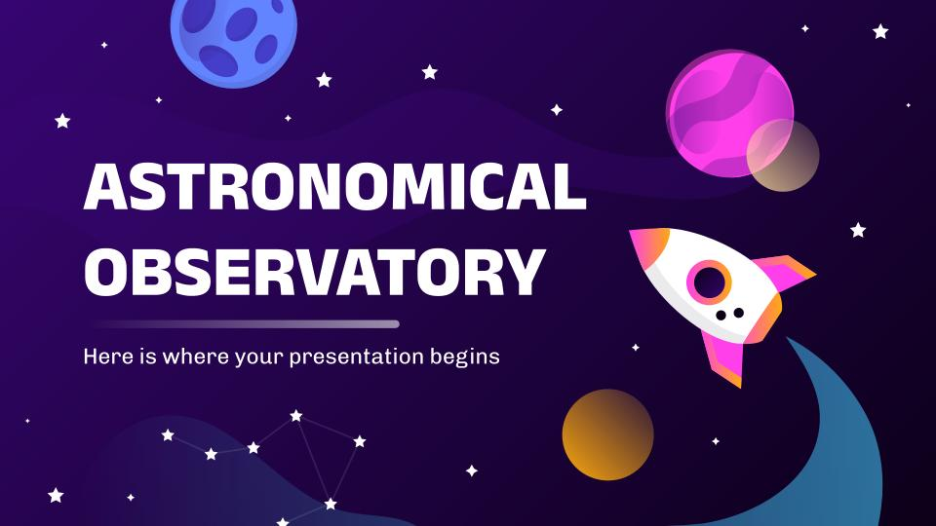
TELESCOPE SOFTWARE
You can replace the image on the screen with your own work. Just right-click on it and select “Replace image”

Slide 23
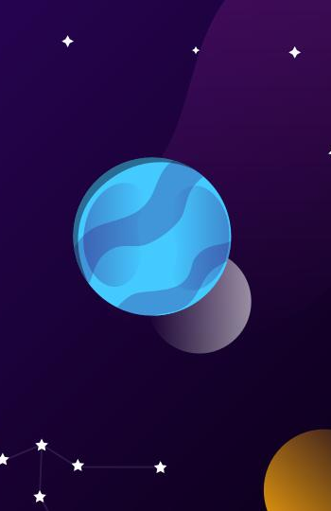
ASTRONOMIC WEBSITE
You can replace the image on the screen with your own work. Just right-click on it and select “Replace image”

Slide 24
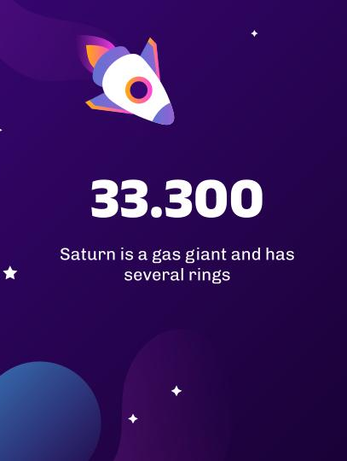
TABLET APP ABOUT STARS
You can replace the image on the screen with your own work. Just right-click on it and select “Replace image”

Slide 25
TELESCOPE MAP
JUPITER
Jupiter is a gas giant and the biggest planet
VENUS
Venus is the second planet from the Sun
NEPTUNE
Neptune is the farthest planet from the Sun

Slide 26
HISTORY OF OBSERVATION
1609
1789
1930
TODAY!
VENUS
MARS
MERCURY
NEPTUNE
Venus has a beautiful name
Mars is a very cold place
It’s the closest from the Sun
It’s the farthest from the Sun

Slide 27
OBSERVED CELESTIAL OBJECTS
1ST
3RD
2ND
4TH
MERCURY
JUPITER
Mercury is the closest planet
Jupiter is a gas giant planet
MARS
NEPTUNE
Mars is actually a cold place
Neptune is an ice giant planet

Slide 28
TYPES OF OBJECTS
EARTH | Earth is the planet with life | Earth is known as the blue planet | All humans live on this planet
MARS | Mars is actually a cold place | Mars is full of iron oxide dust | Mars was named after a god
MERCURY | Mercury is a very small planet | It’s the closest planet to the Sun | Mercury is the smallest of them
VENUS | Venus has high temperatures | Venus has a toxic atmosphere | Venus has a beautiful name

Slide 29
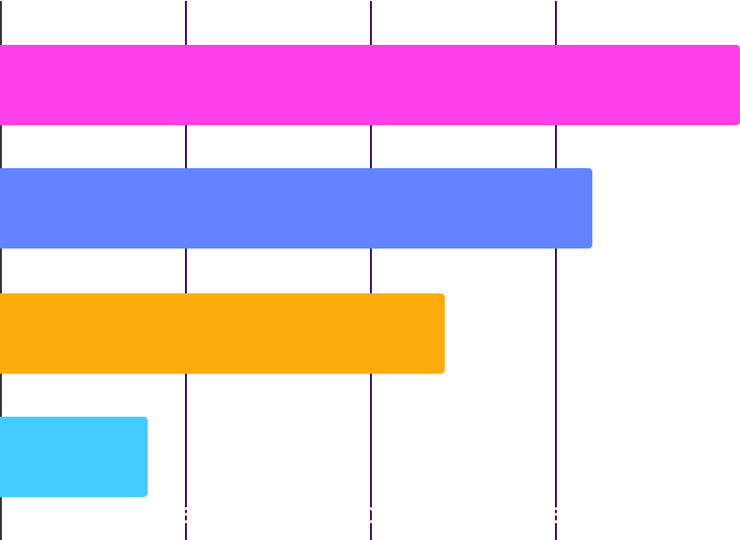
ASTRONOMICAL INSTRUMENTS
1,000
600
800
400
MERCURY
JUPITER
Mercury is the closest planet
Jupiter is a gas giant planet
MARS
NEPTUNE
Mars is actually a cold place
Neptune is an ice giant planet
Follow the link in the graph to modify its data and then paste the new one here. For more info, click here

Slide 30
03
SATELLITE OBSERVATORIES
You could enter a subtitle here if you need it

Slide 31
OUR SATELLITES
MERCURY
VENUS
Mercury is the closest planet to the Sun and the smallest one
Venus has a beautiful name and is the second planet

Slide 32
RANGE OF SATELLITES
5/25
10/25
15/25
20/25
MERCURY
SATURN
MARS
VENUS
It’s the closest planet to the Sun
Saturn is a gas giant planet
Despite being red, Mars is cold
Venus is the second planet

Slide 33
OBSERVATION PLANNING
 | January | February | April | May | June
TASK 1
TASK 2
TASK 3
TASK 4
TASK 5

Slide 34
SATELLITE POSITIONS
90°
30°
60°
0°
MERCURY
JUPITER
Mercury is the closest planet
Jupiter is a gas giant planet
MARS
NEPTUNE
Mars is actually a cold place
Neptune is an ice giant planet

Slide 35


OUR TEAM
CRISTINA SHARP
OLIVER PATH
Here you can talk a bit about this person
Here you can talk a bit about this person

Slide 36
THANKS!
Do you have any questions?
youremail@freepik.com
+91 620 421 838
yourcompany.com
Please keep this slide for attribution

Slide 37
ALTERNATIVE RESOURCES
Here’s an assortment of alternatives resources within the same style of this template
VECTORS
Gradient galaxy background I
Gradient galaxy background II

Slide 38
RESOURCES
Did you like the resources? Get them for free at our other websites.
VECTORS
Gradient space with a rocket I
Gradient space with a rocket II
Gradient space with a rocket III
Gradient galaxy background I
Gradient galaxy background II
Gradient galaxy background III
Gradient galaxy with rocket
Star background
PHOTOS
Beautiful constellations on sky
Virgo constellation on a beautiful starry night
Woman studying in the library
Man between bookshelves

